Slide 1
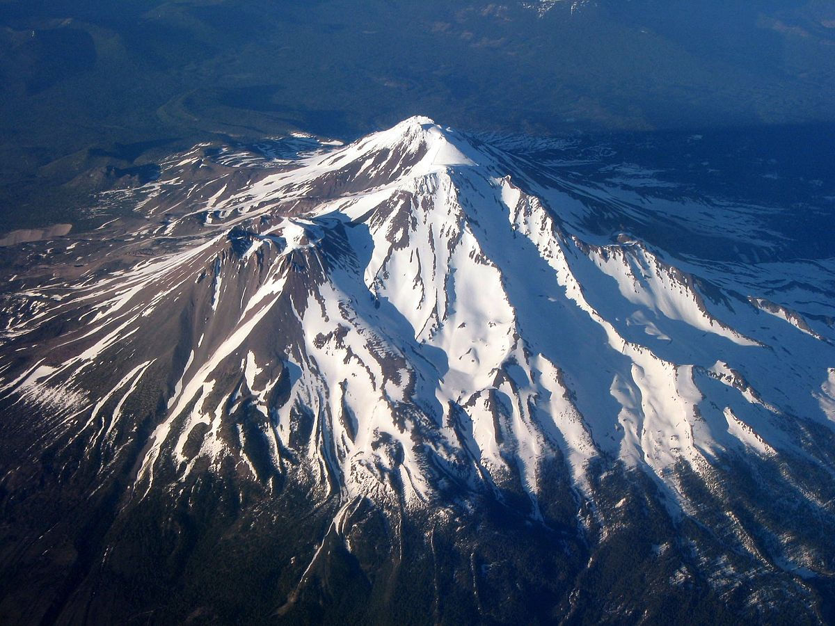
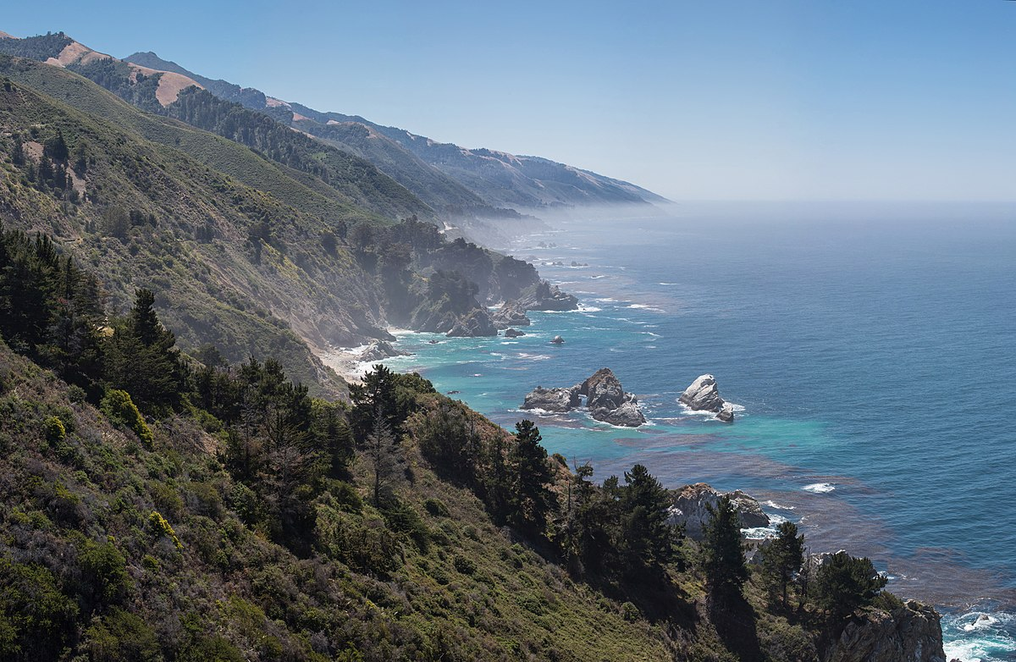
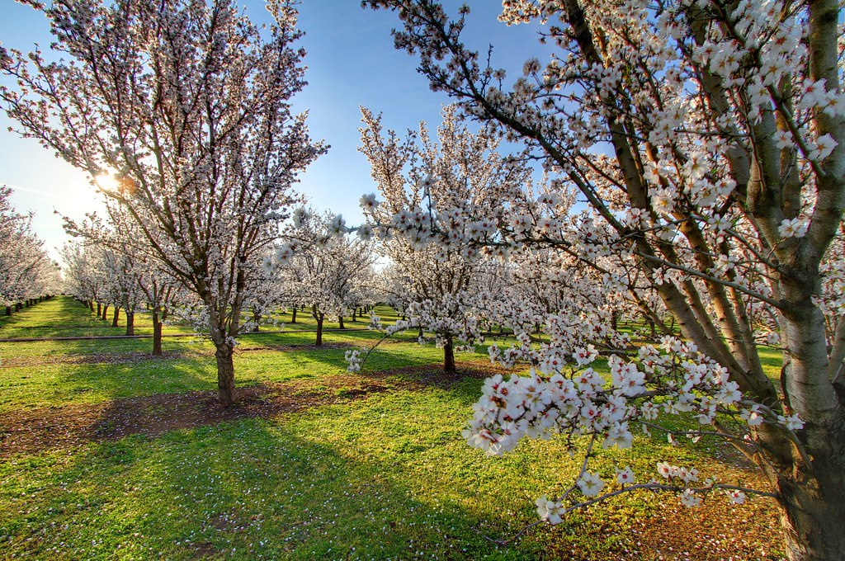
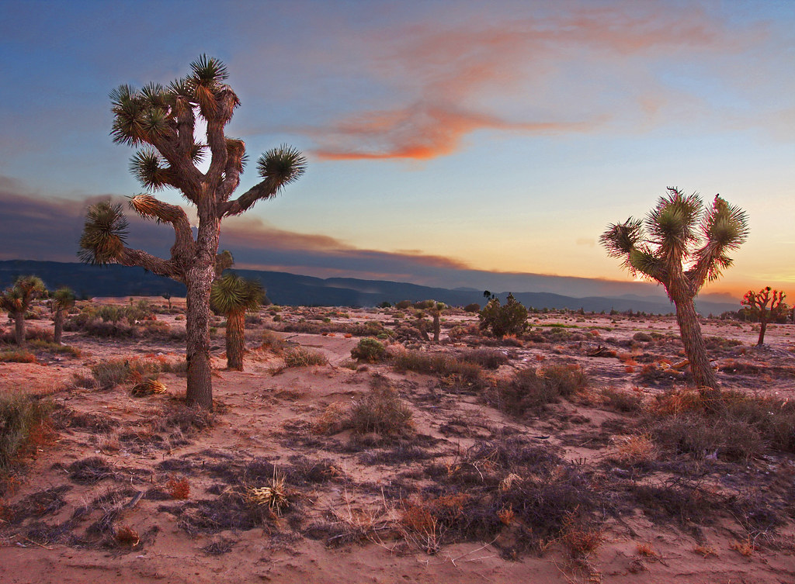
California Regions
Mountains
Coastal
From​ Caleb lee #11 ​
Central
Desert

Slide 2
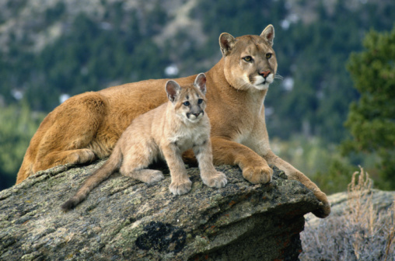
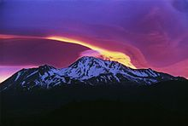
Mountain Region
Plants and Animals
racoons
racer snakes
ravens
mule deer
mountain lion
Landforms & Waterways
Many mountain ranges
serra Nevada largest range in ca
Coastal Mountain range less than 4000 ft
cascade range
mount Shasta - volcano -valley region
mount Lassen - volcano
mount Whitney - tallest 14,500ft
Climate
arctic snow
dry desert
Natural Resources
water
trees or wood
snow
Fun Facts
there are 20 volcanos in California

Slide 3
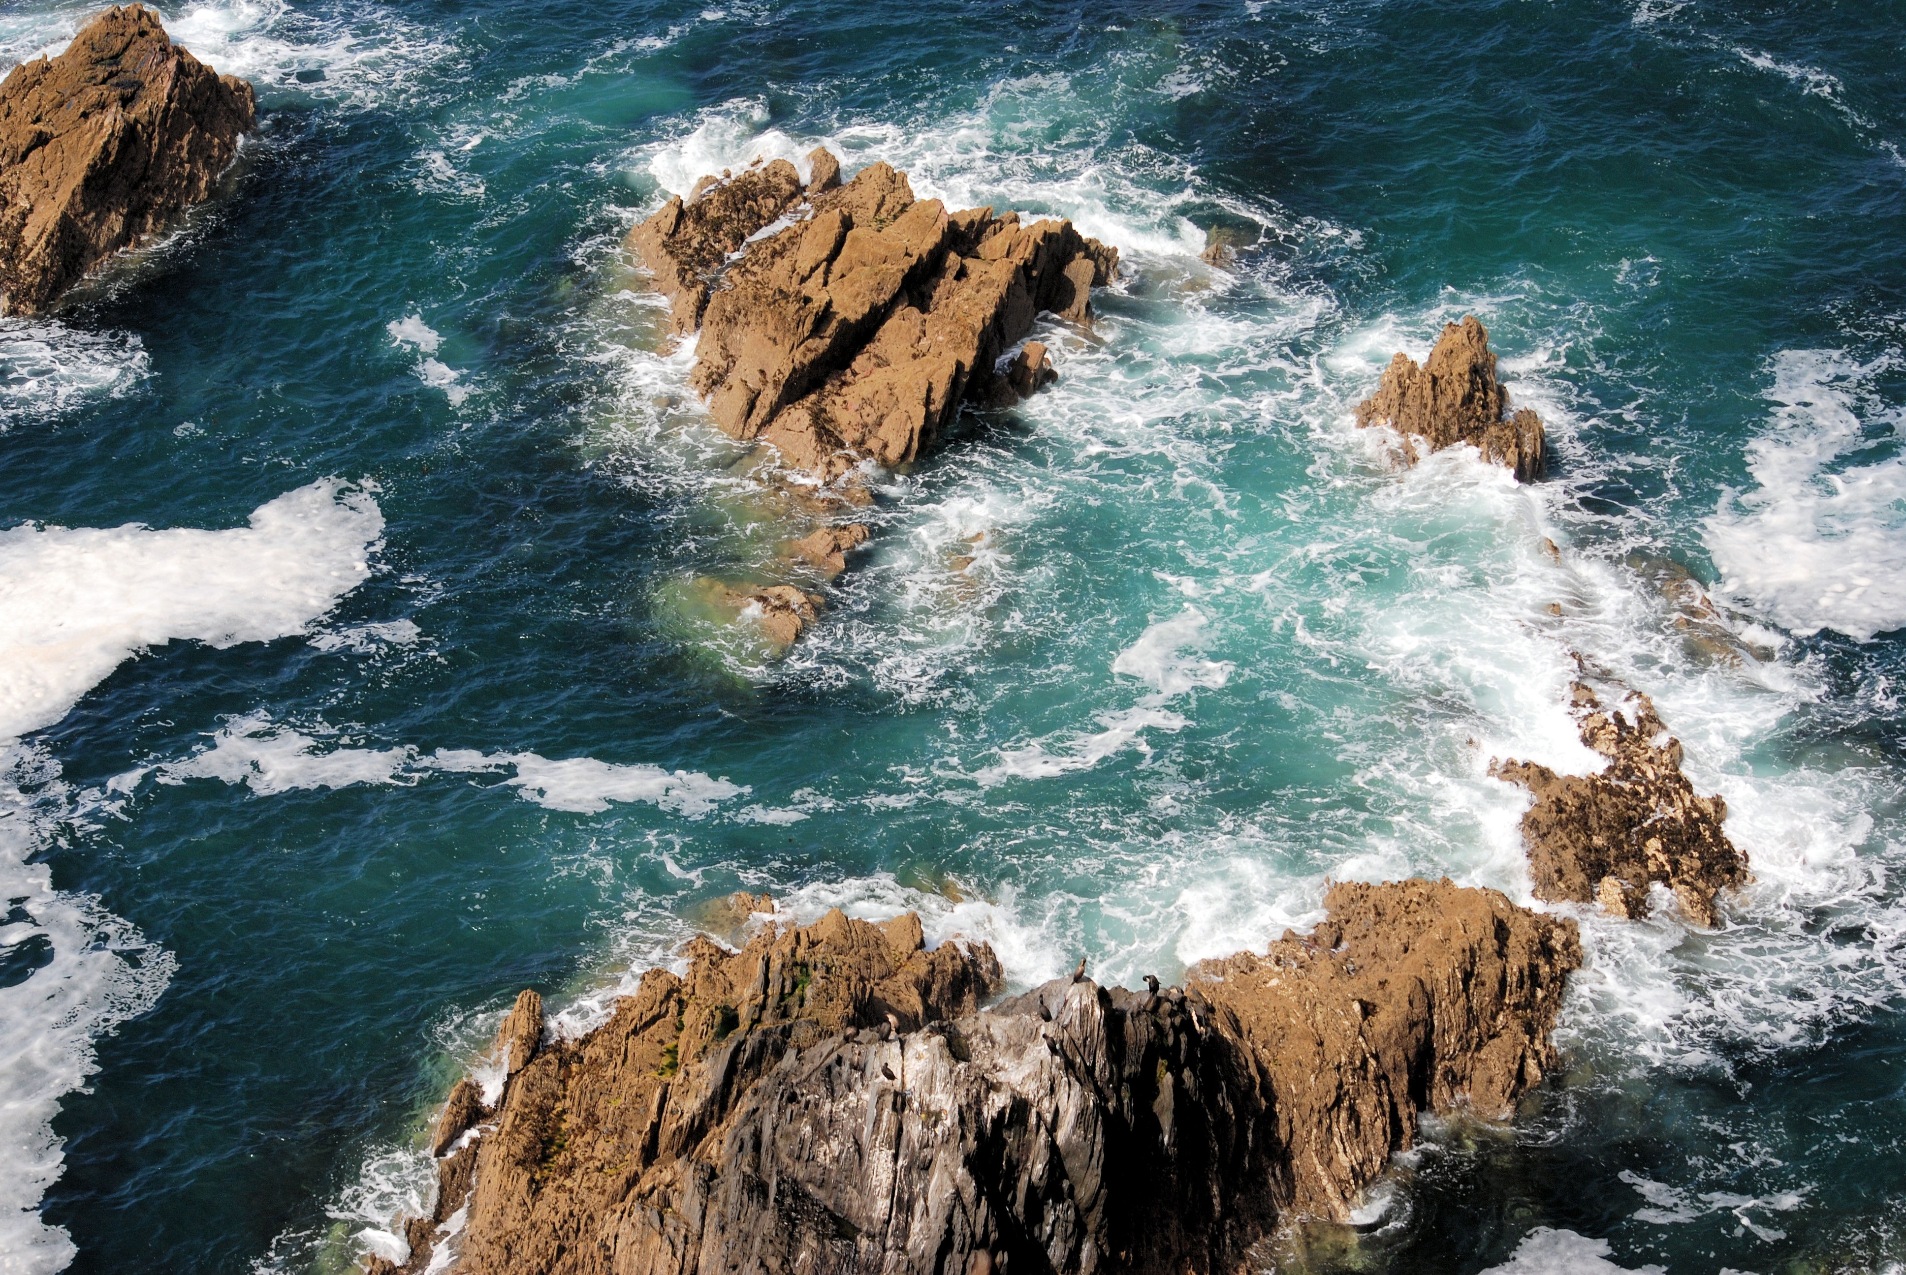
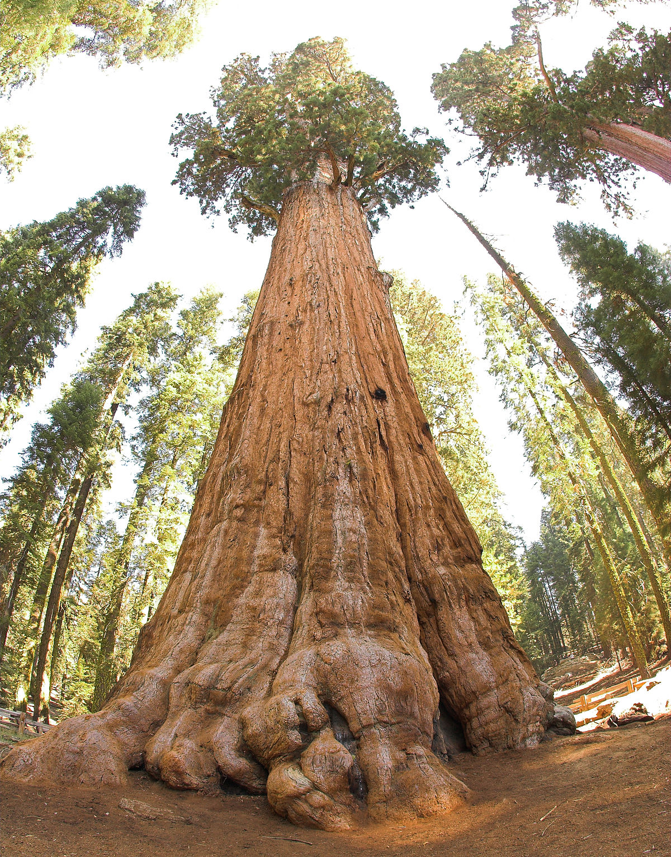
Coastal Region
Plants and Animals
Sea lions
Green sea turtle
Brown pelicans
Elephant seal
humpback whale
Fish
Redwood trees
Landforms & Waterways
Mountain
ocean
Rocky cliffs
Sandy Beaches
Wide plains
Rain Forest
Climate
Mild climate
Slightly Rainy Winters
Dry Summers
Humid
Fun Facts
Home to Giant Redwood Trees that reach up to 350 feet.
The three largest cities in the coastal region are LA, SD, and SF.
Tourism is very important to provides jobs and help the economy.
Natural Resources
Wood
Water

Slide 4

Desert Region
Landforms & Waterways
Mojave, Colorado, Death valley deserts
canals, diches and aqueduct pipes
river
Plants and Animals
desert roadrunner
Lizards, snakes
Joshua tree
prickly pear cactus
yucca
bighorn sheep
Fun Facts
it is hard to live in the desert due to high heat and limited water
irrigation makes it possible for farmers to grow fruits and vegetables.
Colorado desert is over 7 million acres
My favorite cartoon is Oscar Oasis who is a lizard that lives in the desert
Climate
Very Hot Temp can get up to 130 degrees during the day
Cold at Night
Snows in
Natural Resources
sand and rocks
sun

Slide 5
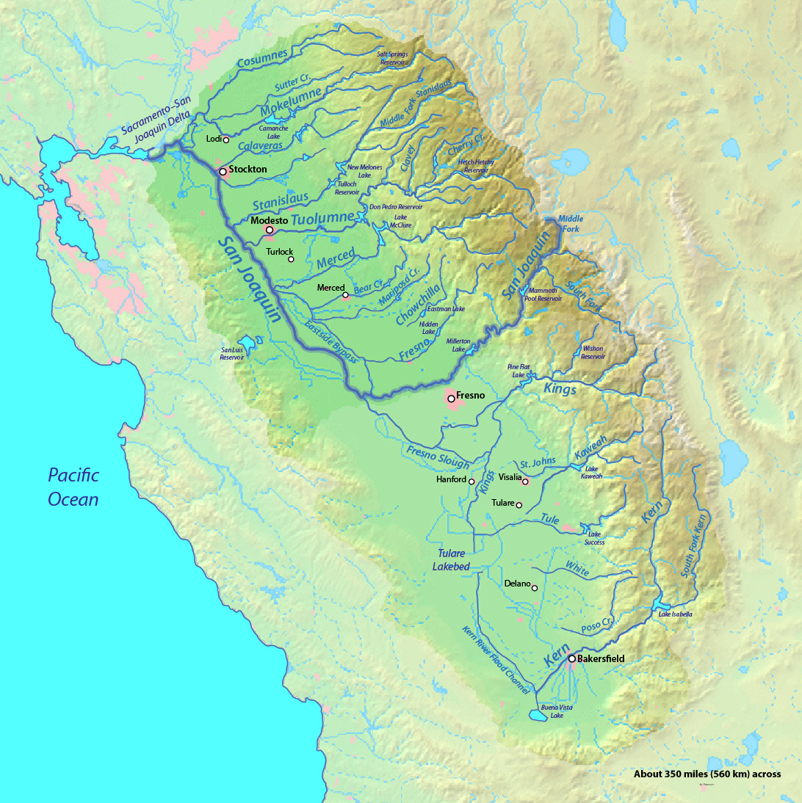
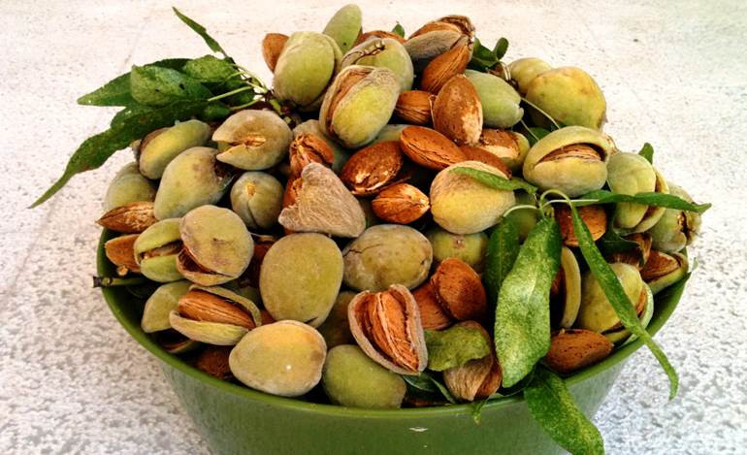
Central Valley Region
Landforms & Waterways
grassland
fields
rivers
marshes
lakes
Climate
hot & dry in summer
cool and wet in winter
Natural Resources
wells
melted mountain snow creates water
mountains
sunshine
fertile soil
Plants and Animals
fruit
Nuts Almonds
cows
Fun Facts
Many of the marshes, lakes and small river have been drained for farming
Ideal for farming and very important to the region. In fact 90% of worlds almonds grow in central valley
We live among the 6 million people in the central valley
Europeans came to this region in 1700 and it was very different from today

